Slide 1
Maven- Quick Start
- Senthil Prasanth K

Slide 2
Approach
Goals, Objectives
Essential Concepts
Minimal Theory
Installation
Windows Installation
Simple Java Projects
Light on Theory
Practical Examples
Short and Focused

Slide 3
Course Tools - Terminal
Starting with Command Line ( Windows CLI, Powershell, Git Bash )
Common Approach across OS, Online help is extensive, Good Teaching tool, Best way to debug
Course Tools -GIT
Best Practice - Version Control ( Git / GitHub / Bitbucket )
Course Tools – Notepad ++
Text Editor ( Windows: Notepad ++ )

Slide 4
What is Maven ?
Build Tool
Java and Others
Automates build tasks
Dependency Management
Repository System
Plugins
Best Practices

Slide 5
Maven - Plugins
Critical component: Everything in Maven
More Functionality and Features
Example
Goals
Dependencies
Convention / Configuration
Useful functionality with little or no configuration
Conventions / Best Practices
Standard Directory Template
Override defaults
Only if needed

Slide 6
POM
Project Object Model (aka) POM
XML document – pom.xml
Project Metadata
Project Name, Description and Start date of project
Maven Coordinates
Identifier of components
Group name, Artefact name and Version Number
Dependencies and Build Settings
Inheritance
Super POM
All projects
Convention over configuration
Project unique Information

Slide 7
Dependency Management
Major Advantage
Automatically Resolve Dependencies
Transitive Dependencies
Dependency of Dependency
Downloaded from Defined Maven Repository
Stored in Local Repository ( Local Cache )
Scope ( Deploy / Test )

Slide 8
Maven Installation
Two Install Processes
Express – Experienced Engineers
Full – Complete, Step by Step
Quick Install
Express way Installation
List of tools needed
Deviation from default ( if any )
Follow the document

Slide 9
Quick Start
Java Project
Small Bits of Theory
Start on GitHub
Create Project
Create standard directory structure
Copy source code and resources
Create POM
Execute Goals, Phases and Lifecycles
Update GitHub

Slide 10
Maven: Building Blocks
Three main groups
Goals
Phases
Lifecycles
Maven: Goals
Similar to Ant tasks
Plugin + goal name
Example: Compile goal on Compiler plugin
Lifecycles

Slide 11
Maven: Phases
One or Many Goals
Part of Greater Lifecycle
Example
Compile maps to compiler:compile
Maven: Lifecycles
Build life cycles takes care of a different aspect of building a software project.
Default: Handles everything related to compiling and packaging your project
Clean: Handles everything related to removing temporary files from the output directory, including generated source files, compiled classes, previous JAR files etc
Site: Handles everything related to generating documentation for your project.

Slide 12
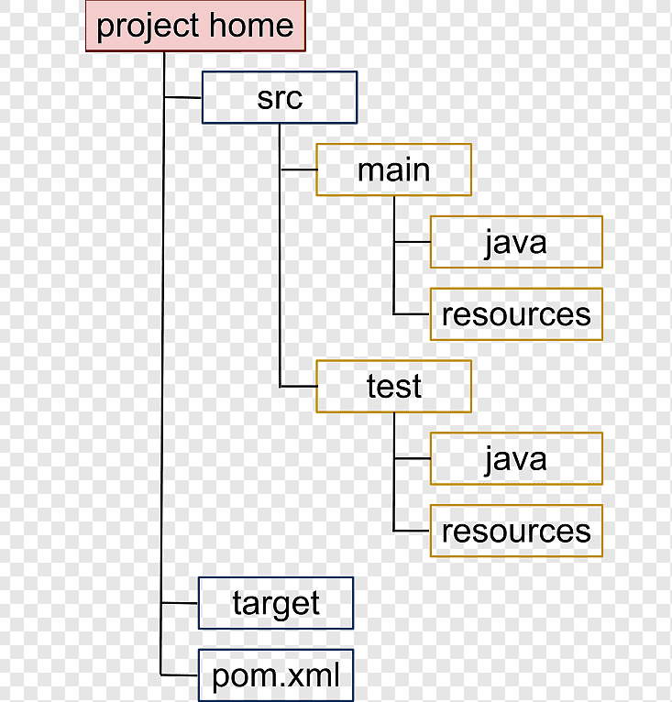
Folders
Configuration over Configuration
Standard Directory Template

Slide 13
Maven: Plugins
Critical Part of Maven
Everything
Default / Core functionality
Additional functionality
Maven ⬄ Plugin Engine
Maven Implement a functionality
Add more Goals
Plugins are also Dependencies
Download from Repositories

Slide 14
Maven examples
Compile source code
Run Unit Tests
Publish to Artifact Repository
Deploy to Remote Server
Publish Documentation
Maven plugins
Basic set of Plugins
Common core
Known to Maven
Downloaded upon reference
Other
Mentioned in Project POM
Change Plugin Behavior
Specify in POM Configuration

Slide 15
Dependencies
Main Advantage : Dependency management
Finding Dependencies ( External Repositories )
Controlling when to use ( scope )
Project A – Automatically resolve dpendencies
Declared Dependency A
Transitive Dependency B
Secondary Transitive Dependency C
Maven Repository
Maven Central – By Default dependency resolved here
Local Repository
Other – remote or external depencency

Slide 16
Dependency Scopes
Six scopes
Four commonly used
Scopes
Compile – Default compilation and execution related. Included in a container (jar/war/ear)
Runtime – Project’s deployment runtime. Included in a container (jar/war/ear)
Test – Needed only for testing. Ex. Unit, Integration etc ..
Provided – Provided by Target runtime or deployment system.
System – Rarely used. Local dependencies at your machine. Not recommended.
Import – Rarely used ( almost never ). Import or replace dependencies from other projects.

Slide 17
Archetypes
Maven archetypes are project templates which can be generated for your need by Maven. In other words, when you are starting a new project you can generate a template for that project with Maven. In Maven a template is called an archetype. Each Maven archetype thus corresponds to a project template that Maven can generate.
Conclusion
Summary
Learned about Maven and its usage
Power of Maven
Core Concepts
Lifecycles | Phases | Goals
Plugins | Dependencies | Tests | Archetypes

